Slide 1

INTRODUCTION TO DATA MANAGAMENT
Project Submission
Video Games Analysis
Submitted by
BAMMIDI SAI CHANDRA SEKHAR
Registration No:11802374
Programme and Section: KMO76
Course Code INT-217
Under the Guidance of
Vasudha with 23636 and asst. Professor

Slide 2
Table of Contents:
Introduction
Scope of Analysis
Cleaning process using tableau
Objectives of my project

Slide 3
Introduction:
A video game is an electronic game that involves interaction with a UI or input device such as joystick, controller, keyboard to generate visual feedback for a player.
More recently the industry has been expanded onto mobile gaming through smartphones and tablet computers, virtual and augmented reality systems, and through cloud gaming.
Data set -1980-2020
Since the 2000’s the commercial importance of the video game industry has been increasing.
Over 164 million adults in the US play video games. And like China and South Korea, India is experiencing strong growth in online gaming, with about 35-50 million users.
This presentation might be useful in discovering trends, perception, and other aspects of gaming industry.

Slide 4
Scope of analysis:
Sales comparison among countries across the globe.
Trends in growth of a platform over years.
Top preferred genre.
This analysis depicts the number of releases by publisher in a year.

Slide 5
Tableau prep:
Tableau prep is a tool used to prepare the data before analyzing it.
It is mainly used to cleanse, aggregate, merge the data.
changes made using tableau prep:
    The unwanted columns had been removed.
    Null values had been removed from two columns.

Slide 6
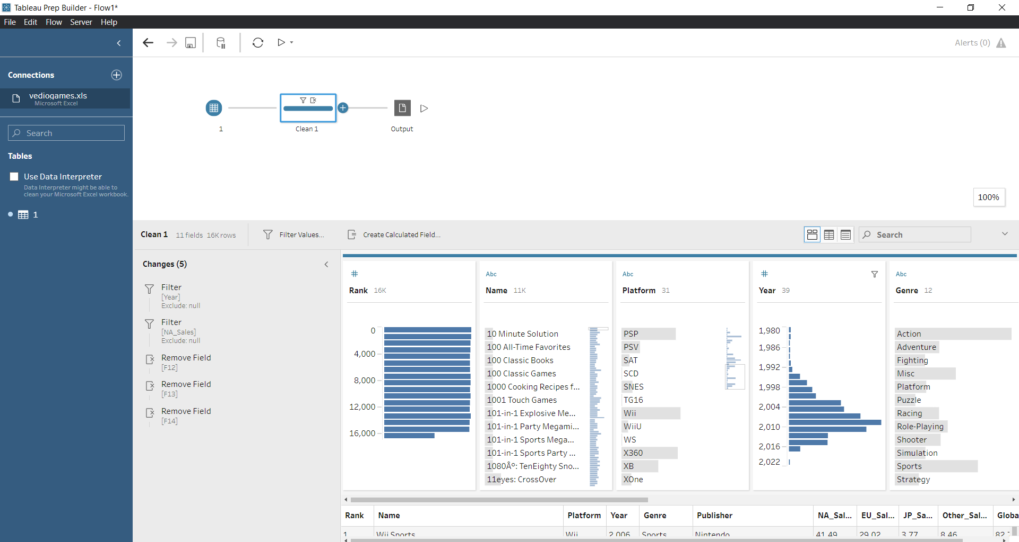
Cleaning process using tableau:

Slide 7
Objectives of my project:
country sales comparison.
sales analysis with respect to publisher.
top genre hits.
number of releases per year.
Global sales comparison.
Finally, I have create a interactive dashboard

Slide 8
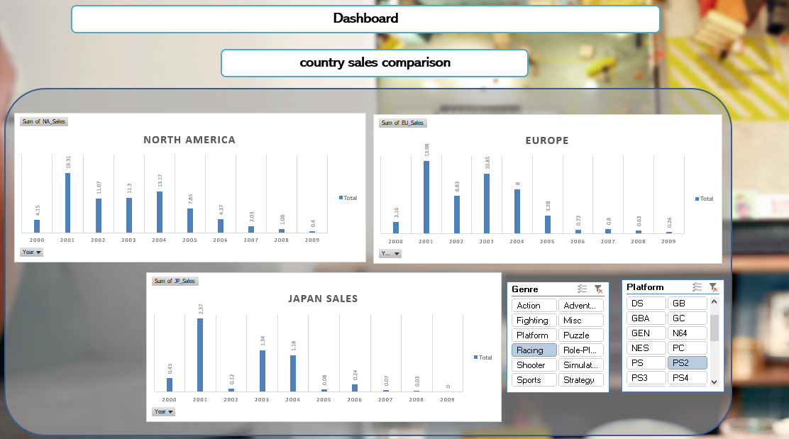
DASHBOARD:

Slide 9
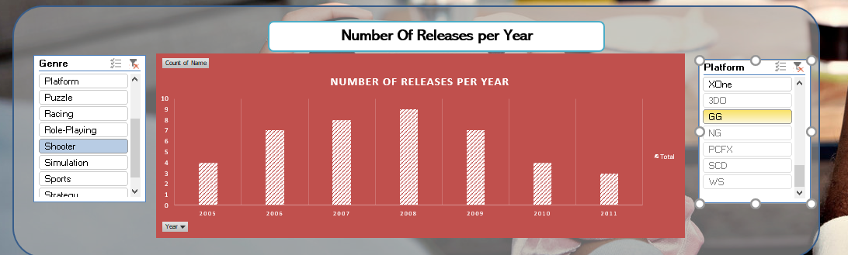
DASHBOARD CONTD.:

Slide 10
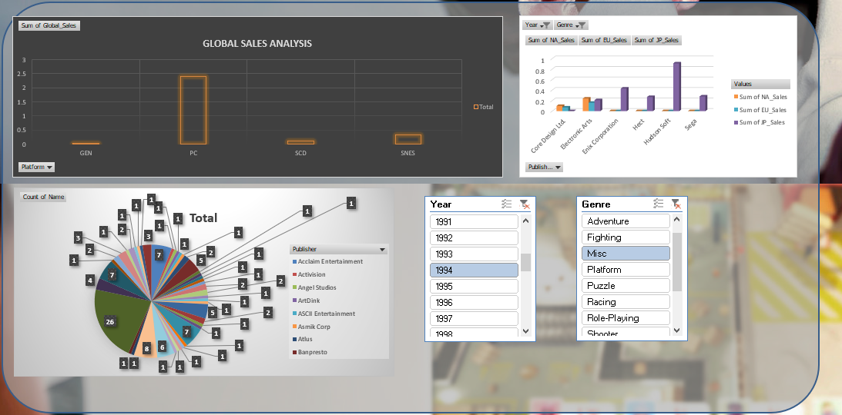
DASHBOARD CONTD.:

Slide 11
THANK YOU

